Slide 1
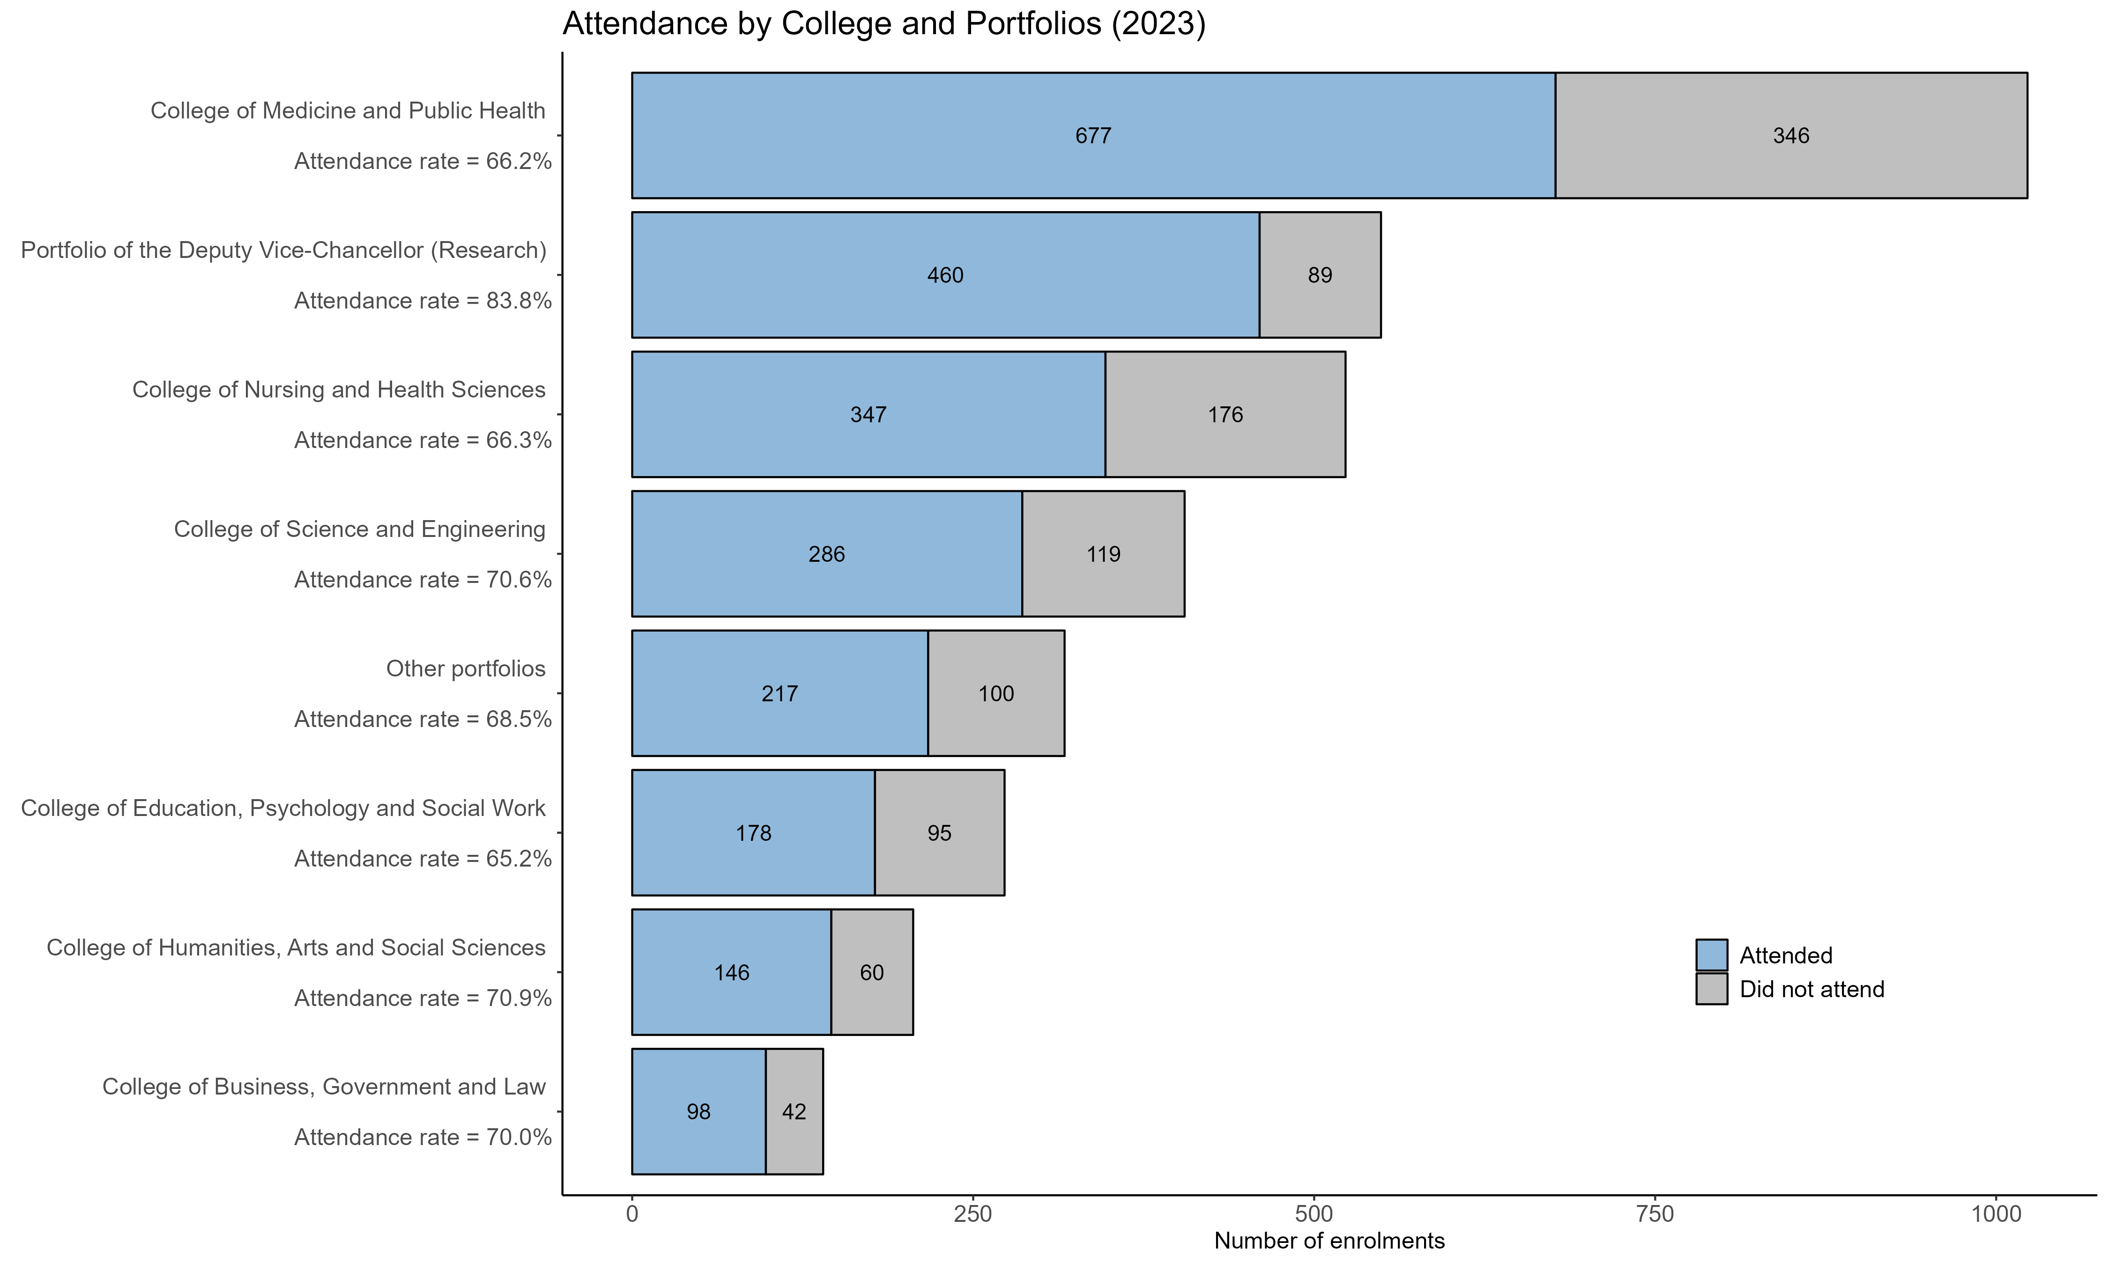
Notes:
December 2023 (complete year)

Slide 2
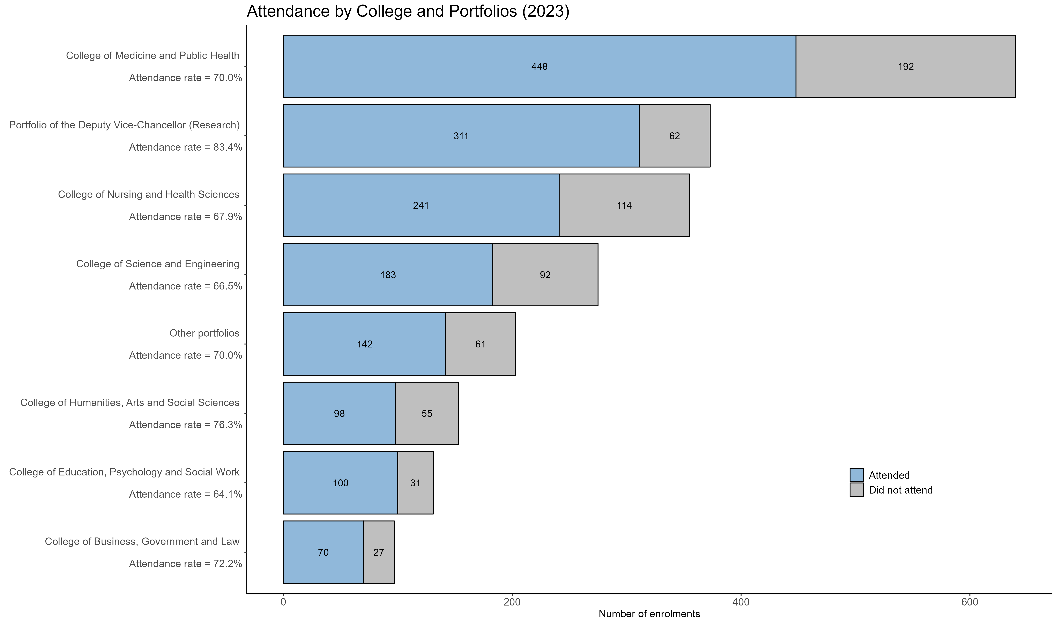
Notes:
October 2023

